Slide 2
Seminar on Real Estate Laws – Income Tax, GST, RERA & RWA

Slide 3
RERA PRESENTATION
Vinay Thyagaraj
Partner M/s. Venu & Vinay
Chartered Accountants, Bengaluru
E. Suhail Ahmed
Partner, M/s. TRIALBASE
Advocates, Bengaluru

Slide 4
_{TOPICS –} _{FOR THE SESSION}
CA Certifications under RERA and Annual Audit of Accounts under RERA
Important Provisions under RERA
And
TN RERA Rules
Professional Perspective and Opportunities
And
Important Decided Caselaws
Professional Perspective and Opportunities

Slide 5
STATEMENT OF OBJECTS AND REASONS OF THE ACT
Ensure Accountability Towards Allottees and Protect their Interest;
Infuse Transparency, Ensure Fair-play and Reduce Frauds & Delays;
Introduce Professionalism and Pan India Standardization;
Establish Symmetry Of Information between The Promoter And Allottee;
Imposing Certain Responsibilities On both Promoter And Allottees;
Establish Regulatory Oversight Mechanism to Enforce Contracts;
Establish Fast- Track Dispute Resolution Mechanism;
Promote Good Governance in the Sector which in turn would create investor confidence;

Slide 6
GOVERNANCE / AUTHORITY
RERA Act comes under the purview of Ministry of Housing & Urban Poverty Alleviation (Central Government) –
Act has X Chapters and 92 Sections
Act Directs respective State Governments to frame the Rules –
Published as Notification No. SRO No A-29(d)/2017 in part III- Section 1(a) at pages 1-55 of the Tamil Nadu Government Gazette Extraordinary (Issue No. 188) dated 22.06.2017
Tamil Nadu Real Estate (Regulation and Development) Rules, 2017
It shall come into force on the 22nd June, 2017
Constitute Real Estate Regulatory Authority
Appoint Adjudicating officer and
Set up Appellate Tribunal

Slide 7
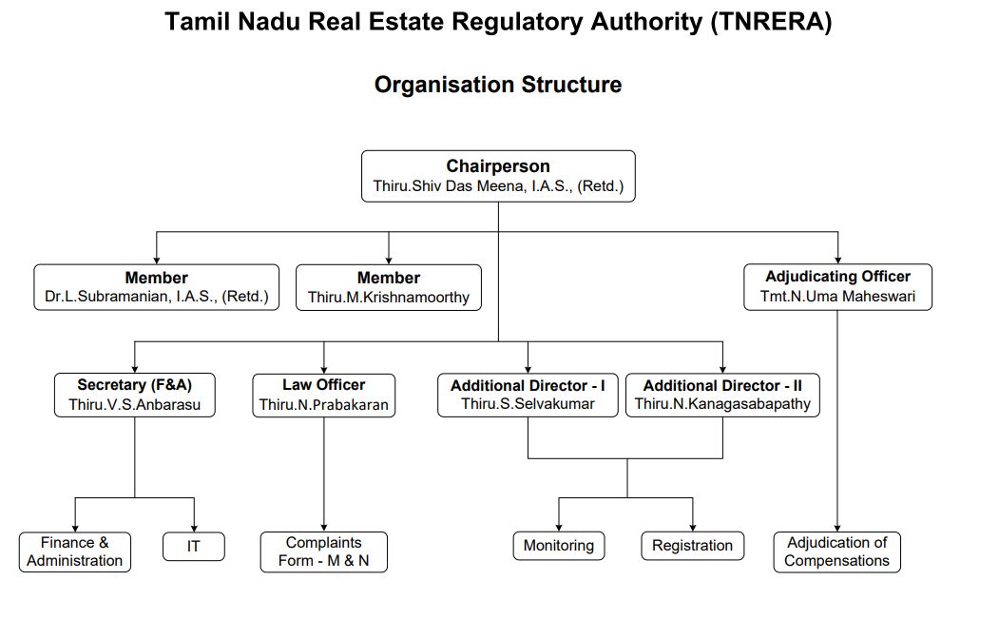
Organisation Structure – TN RERA

Slide 8
STATUTE - RULES, REGULATIONS, ORDERS
RERA
Act 2016
TN- RERA
Rules 2017
TN- RERA
Regulations 2018
Notifications / circulars / Orders
Formats as may be prescribed

Slide 9
RERA - PROJECT LIFE CYCLE
Preparation
Business Plans
Due Diligence
Feasibility
Start
Statutory Approvals
NOC’s
RERA Registration
Bank / Financing
Modification
Extension
Change of professionals
Customer Complaints
During the Development
70 / 30 Collections
Compliances – Quarterly Filing
Annual Audit
Follow mandatory Practices under RERA
End of the project Development
Project Completion
Reporting of Completion
Funds withdrawn
Association formation
Handover possession of common Areas
Handover of Corpus funds to the Association
Handover title deeds / documents
Handover Approvals, plans, NOC
Handover Drawings – plumbing, electricals
Post Completion / Handover
Mortgage Release
Loan / Hypothecation
Sec 17
DLP for 5 years

Slide 10
STAGE WHEN PROJECT CAN BE LAUNCHED AFTER RERA
1 – Due Diligence of Land and Project
6 – Obtain Sanctions of Plans
7 – Prepare All Doc’s for filing RERA Application
2 – Feasibility of the Project / Market Study etc
5- Apply for Noc’s clearances, etc.,
8 – RERA registration
3 – Enter MOU/Agreement with Land Owner/Purchase land
4 – DA / JDA / GPA
9 – LAUNCH / ADVERTISEMENT ETC

Slide 11
FLOW OF SALE/PROCESS - POST RERA
1 - Booking Form
6 - Complete development and
Obtain OC
7 - Conveyance deed within 3 months of OC
2 - Allotment Letter
5- Formation of Association of Allottees once majority of units are booked
8 – Title Insurance / Defect Liability for 5 years
3 - Enter Agreement for Sale
4 - Register Agreement for Sale – if promoter collects > 10 % of total cost
9 – Handover to Association

Slide 12
IMPORTANT / CRITICAL COMPLIANCES UNDER RERA
Prior registration of Project – Section 3 and KA RERA Rules – 3 and 4
Financial management – 70/30 – Section 4 (2) (l) (D)
Annual Audit of Accounts of the Project – Section 4 (2) (l) (D)
Validity of Registration and Extension – Section 6 and KA RERA Rules – 7
Further Extension after Section 6 – Section 7
Advertisement – Section 11 /12
Quarterly updates under RERA – Section 11 KA RERA Rules – 15
Agreement for Sale as per the Format – Section 13 KA RERA Rules – 8 (a)
Association of the Allottees – Section 11 (4)(e)
Conveyance of Common Area of the Project – Section 17
Legal Aspects

Slide 13
RERA - APPLICABILITY
where the area of land proposed to be developed does not exceed five hundred square meters (5382sft) or the number of apartments proposed to be developed does not exceed eight inclusive of all phases.
where the promoter has received completion certificate for a real estate project prior to commencement of this Act;
for the purpose of renovation or repair or re-development which does not involve marketing, advertising selling or new allotment of any apartment, plot or building, as the case may be, under the real estate project.
where the real estate project is to be developed in phases, every such phase shall be considered a stand alone real estate project, and the promoter shall obtain registration under this Act for each phase separately.

Slide 14
REAL ESTATE PROJECT REGISTRATION UNDER RERA

Slide 15
Real estate project
Sec Ref | Term | Definition
2(zn) | real estate project | means the development of a building or a building consisting of apartments, or converting an existing building or a part thereof into apartments, or the development of land into plots or apartment, as the case may be, for the purpose of selling all or some of the said apartments or plots or building, as the case may be, and includes the common areas, the development works, all improvements and structures thereon, and all easement, rights and appurtenances belonging thereto

Slide 16
RERA REGISTRATION-SECTION 3
Prior registration of Project – Section 3 and TN RERA Rules – 3 and 4
KYC of the Promoters and organization documents
Legal Title Documents including Title Search Report
Plan Sanction and NOC related, Mortgage
Area Statement – Carpet, Built-up area, Parking Area, Common Area
Estimated Cost of the project, RERA Designated Project Bank Account
Legal Draft – Allotment Letter, Agreement of Sale, Sale Deed
Professionals associated for the project – Architect, CA, Structural Engineer
Affidavits, undertaking
Online filing of Application and Registration Fees

Slide 17
RERA REGISTRATION-NON COMPLIANCE - SECTION 59
Prior registration of Project – Section 3 and TN RERA Rules – 3 and 4
Non compliance of Section 3 of the RERA Act 2016, shall attract penal action under Section 59, which entitles RERA to levy penalty upto 10 % of the Estimated cost of the project.

Slide 18
REGISTRATION FEES - Fee Structure (for Tamil Nadu)
1. Layouts - Rs/5/- per sq. m. of plottable area including EWS, Roads and OSR
2. Residential buildings –
a) Rs.10/- per sq. m. of FSI area for residential project in which dwelling unit size is less than 60 square meter; b) Rs.25/- per sq. m. of FSI area is > 60 Sq Mtr
3. Commercial buildings - Rs. 60/- per square meter of FSI area;
4. Any other projects - Rs.25/- per square meter of FSI area ;

Slide 19
Conditions of the RERA Registration – Form C
The promoter shall enter into an agreement for sale with the allottees as provided in ‘Annexure A’;
The promoter shall execute and register a conveyance deed in favour of the allottee or the association of the allottees, as the case may be, of the apartment or the common areas as per section 17;
The promoter shall deposit seventy percent of the amounts realised by the promoter in a separate account to be maintained in a schedule bank to cover the cost of construction and the land cost to be used only for that purpose as per sub-clause (D) of clause (l) of sub-section (2) of section 4;
The registration shall be valid for a period of ______ years commencing from _________ and ending with _____________unless renewed by the Real Estate Regulatory Authority in accordance with section 6 read with rule 7 of the Act;
The promoter shall comply with the provisions of the Act and the rules and regulations made thereunder;
The promoter shall not contravene the provisions of any other law for the time being in force in the area where the project is being developed.
If the above mentioned conditions are not fulfilled by the promoter, the regulatory authority may take necessary action against the promoter including revoking the registration granted herein, as per the Act and the rules and regulations made there under.

Slide 20
TN – RERA STATISTICS- As on 7-11-2024
Tamilnadu | 2017 | 2018 | 2019 | 2020 | 2021 | 2022 | 2023 | 2024 | TOTAL
Building
Manual | 243 | 371 | 253 | 490 | 439 | 536 | 505 | 96 | 2,933
Online | 0 | 0 | 0 | 0 | 0 | 0 | 0 | 222 | 222
TOTAL |  |  |  |  |  |  |  |  | 3,155
Layout
Normal | 37 | 193 | 239 | 265 | 533 | 4,498 | 4,824 | 3539 | 14,128
Reguralised |  |  |  |  |  | 5,303 | 89 | 2677 | 8,069
 |  |  |  |  |  |  |  |  | 22,197
TOTAL | 280 | 564 | 492 | 755 | 972 | 10337 | 5418 | 6534 | 25,352

Slide 21
TN – RERA STATISTICS- As on 7-11-2024 – Agent Registration
Tamilnadu | 2017 | 2018 | 2019 | 2020 | 2021 | 2022 | 2023 | 2024 | TOTAL
Manual | 48 | 96 | 688 | 240 |  |  |  |  | 1072
Online |  |  |  |  | 1839 |  |  |  | 1839
TOTAL | 48 | 96 | 688 | 240 | 1839 | 0 | 0 | 0 | 2911

Slide 22
ACCOUNTABILITY OF PROFESSIONALS
BOMBAY HC : 2nd APPEAL 13781 of 2018
M/s Sea Princess Realty Vs Allottees
Project : Gundecha Trillium
Possession Date : 31st December, 2016
MahaRERA order: 16.01.2018,
Decided - Interest for 6 months
MahaREAT order : 4th April, 2018
Conducted joint inspection & Allowed claim for interest for 1 year without relying on the certificate issued by the Architect which gave another date of completion.
Action against Architect for issuing wrong certificate of completion
Order for payment of interest on Delayed possession for 1 year.

Slide 23
RERA RULES CANNOT BE IN DEROGATION OF THE ACT
2020 SCC ONINE MAD 20120 4 LW 865
MADRAS HIGH COURT
SUBHASHINI THULASIRAM vs SPR & RG CONSTRUCTIONS PVT LTD.,
Held:
It is well settled law that the parent Act will prevail over the rules and there cannot be rules contrary to Act. Assuming Rule 2 (h) (ii) gives some relief to the 1st Respondent , it is contrary to Section 3 of the Act. When the Act has come into force on 01-05-2017, the first respondent should have complied with. The principle that the subordinate legislation cannot be in violation of the Act is supported by following decisions of the Apex Court :
Ramesh Mehta V Sanwal Chand Singhvi (2004) 5 SCC 409
Global Energy Ltd v Central Electricity Regulation Commission (2009) 15 SCC 570

Slide 24
REGISTRATION OF THE PROJECT EXEMPTED UNDER RULES
W.P 18843/2022
KARNATAKA HIGH COURT
Cambrian Technologies Pvt Ltd Vs KA RERA & ors., Order dt: 15-02-2023
Held:
The Rules exempt registration of the Project on account of filing of application for grant of OC as on the date of notification of Rules as per Rule 4 of KA RERA rules.
If the project is not required to be registered then the Authority would not get jurisdiction to entertain the compliant

Slide 25
DEVELOPMENT MANAGER TO BE TREATED AS PROMOTER
Gauri Datte Vs. Nirmal Developers and Shapoorji Pallonji Development Managers Private Limited
And 4 Other complainants
Maharashtra Real Estate Regulatory Authority
COMPLAINT No. CC00600000192886
Nirmal Developers is registered as promoter with RERA
Lucrative Properties Limited-LPL (Subsidiary and group company of Shapoorji Pallonji Private Limited)
Nirmal Developers appointed LPL as Development Manager under a Development Management Agreement.
Given exclusive rights to develop the project to LPL as Development Manager
5. Advertisement made showing both DM and Promoter Logos
6. DM agreement mentions – DM is responsible for sales, marketing, CRM, handover possession, assistance in formation of society on behalf of Developer
Ordered that Lucrative Properties Private Limited be added as a Promoter on the webpage of the project within thirty days of the order.

Slide 26
SECTION 2(ZK) - PROMOTER
a person who constructs or causes to be constructed an independent building or a building consisting of apartments, or converts an existing building or a part thereof into apartments, for the purpose of selling all or some of the apartments to other persons and includes his assignees; or
any development authority or any other public body in respect of allottees of
an apex State level co-operative housing finance society and a primary co-operative housing society…..
any other person who acts himself as a builder, coloniser, contractor, developer, estate developer….

Slide 27
RERA APPLIES TO LONG LEASES
2018 SCC OnLine Bom 2074
Lavasa Corporation Limited Vs Jitendra Jagdish Tulsiani & others
Held :
Upheld the decision of the MAHA Real Estate Appellate Tribunal holding that long term lease of '999 years', would definitely amount to sale and is thus covered under RERA.

Slide 28
APPLICABILITY OF RERA TO INDUSTRIAL UNITS
GMR Krishnagiri SIR Limited … Appellant
TN RERA …Respondent
TN RERA APELLATE TRIBUNAL
Appellant entered into MOU with TIDCO to develop SEZ
The object is to develop a specialised industrial area
The entire act and legislative history clearly mentioned about the sale of plots, apartments, etc. Therefore, the very purpose of the enactment is only for the regulation of sale of plots and apartments and not for any other purpose. Hence, the respondent, Real Estate Regulatory Authority, has rightly pointed out that the act has not differentiated plots into housing plots, commercial plots or industrial plots. So there is no infirmity on the findings of the respondent. Hence in such circumstances, this Tribunal comes to the conclusion that this appeal has no merits and not deserved to be allowed.

Slide 29
FINANCIAL MANAGEMENT UNDER RERA

Slide 30
RERA - Financial management – Sec 4
Project Designated Bank Account
Disclose in RERA Registration Application
Scheduled Bank
Allottees Realisation
Mandatory Deposit of
70 % of realization from allottees
Withdrawal of 70 % based on % of Completion of the Project development
Professional Certificates mandatory for withdrawal of money
Utilise the withdrawn money for the specific project

Slide 31
Withdrawal of money from the Designated Bank Account
Rule 5 –
For the purposes of sub-clause (D) of clause (l) of sub-section (2) of section 4 of the Act, the land cost shall be the market value of the land including the costs incurred by the promoter towards the stamp duty and the registration fees for acquiring ownership over the land either for freehold or leasehold
For the purposes of sub-clause (D) of clause (l) of sub-section (2) of section 4 of the Act, the construction cost shall be the cost incurred by the promoter, towards the on-site expenditure for the physical development of the project including the cost incurred by way of fees/charges paid towards obtaining necessary statutory clearances including cost of Transfer of Development Rights, premium Floor Space Index charges, Finance Cost for the construction of the project and professional consulting charges.

Slide 32
Withdrawal of money from the Designated Bank Account
Rule 5 – Explanation
For the purpose of sub-clause (D) of clause (l) of subsection (2) of section 4 of the Act, the
engineer shall certify that the items shown in the cost of construction is matching to the physical condition at the site of the real estate project;
the architect shall certify that the physical condition at the site is built as per the sanctioned plan; and chartered accountant shall certify the cost incurred on construction cost and land cost;
the chartered accountant shall also certify the proportion of the cost incurred on construction and land cost to the total estimated cost of the project.
After completion of the project, the promoter shall be entitled to withdraw the balance amount lying in the separate account subject to obtaining the certificate from the engineer, architect and chartered accountant as mentioned above.

Slide 33
FORMATS OF PROFESSIONAL CERTIFICATES – Regulations
The certificates to be issued by the project architect, project engineer and chartered accountant in practice for withdrawal of money from the separate account maintained under Section 4(2) (1) (D) of the Act shall be in
Form 1 - Architect
Form 2 – Engineer
Form 3 - CA
The promoter shall furnish a Certificate from the Bank on their letter head as per the prescribed format Form 6 under Section 4(2)(1)(D).
The annual report on statement of accounts in Form 7 (CA), issued in accordance with the 3rd Proviso( D) to Section 4 (2)(l) of the Act (i.e.,) shall be certified and signed by the Statutory Auditor of the promoter’s enterprise.
The promoter shall designate an architect, an engineer, a chartered accountant who issues certificates for the project to enable withdrawal of amounts from the separate account opened in compliance of the provisions under Section 4 (2) (1) (D) of the Act for the work completed and such designated architect, engineer and chartered accountant shall not be changed without prior concurrence of the Authority

Slide 34
FORMATS OF PROFESSIONAL CERTIFICATES - Regulations
Explanation 1: The Chartered Accountant certifying the progress of the registered real estate project for the purpose of withdrawal of amounts from the separate account should be a “different entity” than the Chartered Accountant who is the statutory auditor of the promoter’s enterprise.
Explanation 2: If the Form 7 issued by the statutory auditor reveals that any certificate issued by the project architect, engineer or the chartered accountant has false or incorrect information, the amount collected for a particular project have not been utilized for the project and the withdrawal has not been complied with development of the project, the Authority shall, apart from taking action against the promoter under the Act and Rules, also bring the matter to the concerned respective regulatory body of the said architect, engineer or chartered accountant, for necessary penal action against them.

Slide 35
PROFESSIONALS UNDER RERA
Engineers
Architect
Chartered Accountants
Lawyer / Advocates
Surveyors
Section 56 enables Chartered Accountants or Company Secretaries or Cost Accountants also to appear before AO, Authority and Appellate Tribunal to represent a Applicant or a Appellant

Slide 36
QUARTERLY UPDATES

Slide 37
1. SECTION 11 2. TN RERA RULE 17 (D) MANDATORY COMPLIANCE UNDER RERA TO MONITOR THE PROGRESS OF THE DEVELOPMENT OF THE PROJECT AND OTHER DETAILS

Slide 38
CONTENTS OF QUARTERLY UPDATES
List of number and types of apartments or plots, as the case may be, booked;
List of number of parking lots booked;
Status of the project:
(A) Status of construction of each building with photographs;
(B) Status of construction of each floor with photographs;
(C) Status of construction of internal infrastructure and common areas with photographs.
Status of approvals:
(A) Approval received;
(B) Approvals applied and expected date of receipt;
(C) Approvals to be applied and date planned for application;
(D) Modifications, amendment or revisions, if any, issued by the competent authority with regard to any licence, permit or approval for the project.

Slide 39
COMPLIANCE OF MANDATE OF QUARTERLY UPDATES
Non-Compliance of quarterly filing within the due date
Details shall be accurate and complete
Professional certificates – reliance is based
Penalty can be levied, which may be upto 5 % of estimated cost of the project – Section 60 of the RERA Act 2016

Slide 40
Advertisements and guidelines

Slide 41
ADVERTISEMENT GUIDELINES
Regulations 8 | The promoter shall prominently display at the project site the sanctioned plans, layout plans, along with specifications, approved by the Competent Authority and RERA registration details.
 | In all advertisement and publicity related to the projects in any print, electronic on social media (including press, electronic media, pamphlets, banners, posters or publicity in any form), shall bear the registration details of the project with the RERA, and if the project does not fall within the ambit of RERA as per Section 3 (2) that should also be indicated.
RERA Act | Section 12 – Veracity of advertisement
 | Section 11 – All advertisement shall have RERA Registration Number – prominently displayed

Slide 42
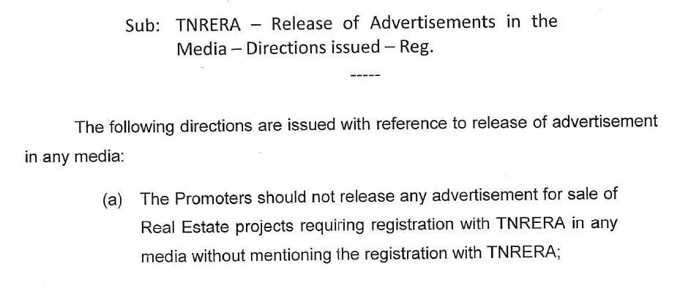
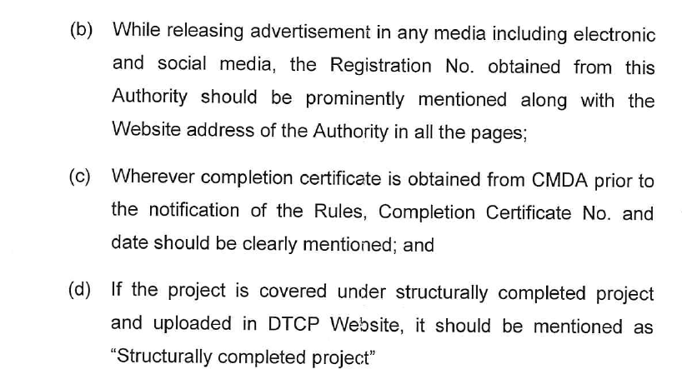
Advertisement Guidelines

Slide 43
EXTENSION / RENEWAL OF RERA REGISTRATION
OF RERA REGISTRATION

Slide 44
EXTENSION / RENEWAL OF REGISTRATION – SEC 6 /RULE 7
Section 6 of the RERA Act
TN RERA Rule 7
Application in Form E
Application to be filed 3 months before expiry of registration
Extension fees – 10% of the Registration fees (for 1 year)
Rule 7(5)
Any sale of an unit in any development project after the lapse of registration period with the Authority and after obtaining the completion certificate from the Competent Authority within the prescribed period as per local laws shall not be treated as offence as prescribed in sub section (2) of section 59 of the Act.

Slide 45
MODIFICATION OR AMENDMENTS TO RERA REGISTRATION

Slide 46
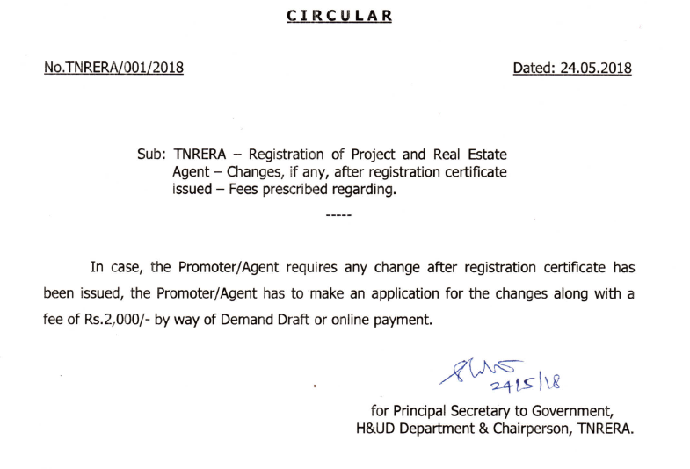
MODIFICATION OR AMENDMENTS TO RERA REGISTRATION

Slide 47
COMPLETION UNDER RERA

Slide 48
COMPLETION UNDER RERA
On completion of development of the project-
Internal development
External development
On Project Completion - Submit
Occupancy Completion certificate
Consolidated Bank Statement
Mortgage release
Structural Liability Certificate (for Building)
Sold and Unsold Inventory
Association of Allottees (for Building)
Project Photograph
Common Areas / Amenities handed over to the Association – Affidavit
Professional Certificates –
Form 4 CC – CA
Engineer
Architect

Slide 49
COMPLETION UNDER RERA
TN RERA Rules – Explanation to Rule 5
After completion of the project, the promoter shall be entitled to withdraw the balance amount lying in the separate account subject to obtaining the certificate from the engineer, architect and chartered accountant as mentioned above.

Slide 50
AGREEMENT OF SALE - AOS

Slide 51
AGREEMENT FOR SALE - AOS
Section 2(c)"agreement for sale" - means an agreement entered into between the promoter and the allottee;
Section 13 (1) A promoter shall not accept a sum more than ten per cent of the cost of the apartment, plot, or building as the case may be, as an advance payment or an application fee, from a person without first entering into a written agreement for sale with such person and register the said agreement for sale, under any law for the time being in force.

Slide 52
AGREEMENT FOR SALE - AOS
Section 13 (2) The agreement for sale referred to in sub-section (1) shall be in such form as may be prescribed and shall specify the particulars of development of the project including the construction of building and apartments, along with specifications and internal development works and external development works, the dates and the manner by which payments towards the cost of the apartment, plot or building, as the case may be, are to be made by the allottees and the date on which the possession of the apartment, plot or building is to be handed over, the rates of interest payable by the promoter to the allottee and the allottee to the promoter in case of default, and such other particulars, as may be prescribed.

Slide 53
TN RERA Rule 9- AGREEMENT FOR SALE and Construction Agreement -
TN RERA Rule 9(1) For the purpose of sub-section (2) of section 13 of the Act, the agreement for sale of undivided share of land or plot of land and construction agreement for construction of apartment, as the case may be, shall be in the Form in Annexure ‘A’ –
Project relating to construction of apartment, the promoter may convey the undivided share of land including the proportionate share in the common area directly to the respective allottees.
Under the agreement for sale or construction agreement, the promoter is permitted to allocate exclusive right of usage of Reserved Car Park to the allottee and such right of exclusive usage shall form an indivisible part of the apartment and shall be transferable along with the apartment

Slide 54
SC :CIVIL APPEAL NO(S). 3533-3534 OF 2017 INT & REFUND ON DELAYED POSSESSION BEYOND 3 YEARS
M/s. FORTUNE INFRASTRUCTURE (NOW KNOWN AS M/S. HICON INFRASTRUCTURE) V/s TREVOR D’LIMA & ORS.
Held
Upheld the decision of NCDRC that in the absence of date of Possession in the Agreement is not mentioned, 3 years will be reasonable time from the date of booking.
Authorities/ Appellate Tribunals have relied upon this and passed number of decisions.

Slide 55
RERA TO SUPERSEDE ONE SIDED AGREEMENT
MAHAREAT APPEAL NO. AT -10679
Mr. Sandeep Shivram Jadhav Vs Rahul Excellence
Date: 15th March, 2019
The order of MahaRERA for allowing the deduction of 20% of the agreement value by the Promoter as per the registered agreement, challenged.
Held
Adjudicating officer committed error in deducting 20% as per deduction clause in an agreement while allowing exit.
Section 18(1)(a) of RERA Act 2016 will prevail over said deduction clause of agreement which took place prior to application of provisions of RERA.
Any term or condition in an agreement which are against the spirit of provisions of RERA cannot be implemented as parties are governed by obligations and duties as per RERA.

Slide 56
Association of Allottees and Formation of Association

Slide 57
TN RERA Rules - Formation of association – Rule 10
Section 11 of the RERA Act mandates the promoter to enable the formation of the Association in accordance with the local laws.
TN RERA Rule 10
The association of allottees shall be formed, registered and governed by the provisions contained in the Tamil Nadu Apartment Ownership Act, 1994 (Tamil Nadu Act 7 of 1995), and the applicable rules for the time being in force. The Association shall take over the maintenance of the project including the common areas and amenities provided in the project within 3 months from the date of intimation by the promoter upon completion of the project

Slide 58
RATE OF INTEREST PAYABLE BY PROMOTER AND ALLOTTEE AND TIMELINES FOR REFUND.
TN RERA Rule 18 -
The rate of interest payable by the promoter to the allottee or by the allottee to the promoter, as the case may be, shall be the State Bank of India highest Marginal Cost of Lending Rate plus two per cent: Provided that in case the State Bank of India Marginal Cost of Lending Rate is not in use it would be replaced by such benchmark lending rates which the State Bank of India may fi x from time to time for lending to the general public.
TN RERA Rule 19 –
If the allottee defaults in making timely payment as per terms of the agreement, the allottee shall not have the right of claiming any interest or compensation from the promoter.

Slide 59
Timelines for refund – TN RERA Rule 19
Any refund of monies along with the applicable interest and compensation, if any, payable by the promoter in terms of the Act or the rules and regulations made thereunder, shall be payable by the promoter to the allottee within Ninety days from the date on which such refund along with applicable interest and compensation, if any, becomes due.
In case of termination of the agreement as per the terms recorded therein, such refund and/or penalty and/or compensation shall be made by the party-in-breach to the other party simultaneous to the execution of appropriate cancellation agreement and registration, if required. If the defaulting party fails to come forward for execution of registration agreement, the Authority shall have the right to execute such agreement on behalf of the defaulting party.

Slide 60
OFFENCES AND PENALTIES – UNDER RERA ACT
RERA Provision | Promoter | Agent | Allottee
Non-registration of project/agent with RERA and continue to do so | Up to 10% of project cost and imprisonment of 3 years for continuous default | Penalty of INR10,000 per day during default tenure up to 5% of property cost
False information while making an application to RERA | Up to 5% of the estimated project cost
Non-compliance with any provisions of the Act | Up to 5% of the estimated project cost | Up to 5% of the property cost
Non-compliance with the aforesaid order of RERA | Up to 5% of the estimated project cost | Up to 5% of cost property cost | Up to 5% of cost property cost
Non-compliance with the aforesaid order of the Appellate Tribunal | Up to 10% of cost and imprisonment of up of up to 3 years or both | Up to 10% of cost and imprisonment of up of up to 1 years or both | Up to 10% of cost and imprisonment of up of up to 3 years or both

Slide 61
OFFENCES AND PENALTIES – Terms and conditions and the fi ne payable for compounding of offence – TN RERA Rule 36
RERA Act 2016 Penalty | Money to be paid for compounding the offence.
Imprisonment under sub section (2) of section 59 | Up to 10% of the estimated cost of the real estate project
Imprisonment under section 64 | Up to 10% of the estimated cost of the real estate project
Imprisonment under section 66 | upto 10% of the estimated cost of the plot, apartment or building, as the case may be, of the real estate project, for which the sale or purchase has been facilitated.
Imprisonment under section 68 | upto 10% of the estimated cost of the plot, apartment or building, as the case may be:

Slide 62
UNIFORM AGREEMENT FOR SALE
Supreme Court has directed Union Govt to prescribe Uniform Agreement and uniform RERA Rules across India as per RERA.
Hearing a PIL by Ashwini Upadhyay Hon’ble SC has directed that based upon the responses from state Govts, the Central Government along with the amicus curiae would prepare a model agreement for sale containing –
Part A: 'Core' clauses in consonance with the mandatory provisions of the Real Estate (Regulation and Development) Act 2016, for the protection of the home buyers. These clauses cannot be altered by any State/UT and must necessarily be a part of every agreement for sale."
Part B: Additional clauses based on individual needs and exigencies of each State/UT as permissible within the scheme of the 2016 Act. However, these clauses must not be contrary to or dilute in any manner the clauses in Part 'A'," it said.
Held: The bench noted that after considering the response from 11 states on the model agreement for sale, union govt would submit the same for consideration and for its approval. "The states/UTs shall then incorporate the same in the agreement for sale.

Slide 63
SUPREME COURT OF INDIA Civil Appeal Nos. 3642-3646/2018 in judgment dated 29.08.2024 AKSHAY & ANR. VERSUS ADITYA & ORS.
Appeals filed by landowners, Akshay & Anr. against orders of National Consumer Disputes Redressal Commission (NCDRC) and Maharashtra State Consumer Disputes Redressal Commission (State Commission) were dismissed. Landowners who had entered into a joint venture agreement (JVA) with the developer M/s. Glandstone Mahaveer Infrastructure Pvt. Ltd., contested liability for delays and non-performance in constructing and delivering apartments to the consumer allottees basis the revocation of POA.
Upheld that landowners were liable under JVA and the irrevocable power of attorney executed with Respondent No. 2. Despite a subsequent revocation notice by the appellants, it was deemed ineffective as it came after agreements had been made with the consumer allottees
Both NCDRC and Supreme Court found the landowners and promoter jointly responsible for fulfilling the terms of the agreements, which included completing the construction and delivering possession to the complainants. The judgment reaffirms that landowners cannot evade consumer obligations by revoking powers of attorney after commitments have been made to buyers under a valid agreement.

Slide 64
CIVIL APPEAL NO(S). 6745 6749 OF 2021 (Arising out of SLP(Civil) No(s). 37113715 OF 2021) M/s. NEWTECH PROMOTERS AND DEVELOPERS PVT. LTD. V/s. STATE OF UP & ORS. ETC.
Question 1: Whether the Act 2016 is retrospective or retroactive in its operation and what will be its legal consequence if tested on the anvil of the Constitution of India?
Answer: RERA operates retroactively, not retrospectively. This means that RERA applies to projects that were ongoing at the time the Act came into effect, regardless of when the project agreements were executed. The Court justified this approach as constitutional, emphasizing that RERA is intended to protect consumer rights without invalidating prior agreements.
Question 2: Whether the authority has jurisdiction to direct return/refund of the amount to the allottee under Sections 12, 14, 18 and 19 the Act or the jurisdiction exclusively lies with the adjudicating officer under Section 71 of the Act?
Answer: Held that from the scheme of the Act of which a detailed reference has been made and taking note of power of adjudication delineated with the regulatory authority and adjudicating officer, what finally culls ‘refund’, ‘interest’, ‘penalty’ and ‘compensation’, a conjoint reading of Sections 18 and 19 clearly manifests that when it comes to refund of the amount, and interest on the refund amount, or directing payment of interest for delayed delivery of possession, or penalty and interest thereon, it is the regulatory authority which has the power to examine and determine the outcome of a complaint. At the same time, when it comes to a question of seeking the relief of adjudging compensation and interest thereon under Sections 12, 14, 18 and 19, the adjudicating officer exclusively has the power to determine, keeping in view the collective reading of Section 71 read with Section 72 of the Act. If the adjudication under Sections 12, 14, 18 and 19 other than compensation as envisaged, if extended to the adjudicating officer as prayed that, in our view, may intend to expand the ambit and scope of the powers and functions of the adjudicating officer under Section 71 and that would be against the mandate of the Act 2016.

Slide 65
Question 3: Whether Section 81 of the Act authorizes the authority to delegate its powers to a single member of the authority to hear complaints instituted under Section 31 of the Act?
Answer: Held that in view of the remedial mechanism provided under the scheme of the Act 2016, in our considered view, the power of delegation under Section 81 of the Act by the authority to one of its member not only well defined but expressly permissible and that cannot be said to be dehors the mandate of law.
Question 4. Whether the condition of pre-deposit under proviso to Section 43(5) of the Act for entertaining substantive right of appeal is sustainable in law?
Answer: The obligation cast upon the promoter of predeposit under Section 43(5) of the Act, being a class in itself, and the promoters who are in receipt of money which is being claimed by the home buyers/allottees for refund and determined in the first place by the competent authority, if legislature in its wisdom intended to ensure that money once determined by the authority be saved if appeal is to be preferred at the instance of the promoter after due compliance of predeposit as envisaged under Section 43(5) of the Act, in no circumstance can be said to be onerous as prayed for or in violation of Articles 14 or 19(1)(g) of the Constitution of India.
Question 5. Whether the authority has power to issue recovery certificate for recovery of the principal amount under Section 40(1) of the Act?
Answer: Yes, the amount which has been determined and refundable to the allottees/home buyers either by the authority or the adjudicating officer in terms of the order is recoverable within the ambit of Section 40(1) of the Act.

Slide 66
In the High Court of Judicature at Bombay Wadhwa Group Housing Private Ltd. V/s. Mr. Vijay Choksi and SSS Escatics Pvt. Ltd. SECOND APPEAL (Stamp) No. 21842 OF 2023
KEY FINDINGS:
1. Joint Liability Under RERA: The Court upheld the broad definition of "Promoter" in RERA (Section 2(zk)) and confirmed
that all promoters in a project, including landowners and investors, share joint responsibility for project obligations, including refunds.
2. Circular of MahaRERA (2017): This clarified that multiple promoters in a joint venture must be listed, holding joint liability for the
project.
3. Refund Liability: Even if one promoter didn't directly receive funds, they are liable for refunds under Section 18 of RERA if they
remain part of the joint venture after project registration.
4. Joint Accountability: Promoters can’t escape refund obligations by internal agreements that aren't disclosed to homebuyers.
5. No Privity of Contract Defense: A lack of direct contractual relation between a promoter and an allottee doesn’t absolve
liability under RERA.
5. Pre-RERA Projects: The Act applies retrospectively to ongoing projects, emphasizing consumer protection.

Slide 67
Pioneer Urban Land and Infrastructure Ltd Vs Union of India & Others
SUPREME COURT :WP 43 OF 2019 Order Dated: 9th August, 2019
The case of Pioneer Urban Land and Infrastructure Ltd. & Anr. v. Union of India & Ors. (2019) deals with the constitutional validity of the amendments made to the Insolvency and Bankruptcy Code (IBC), 2016, particularly those deeming homebuyers as "financial creditors."
Key points:
Homebuyers as Financial Creditors: The amendments allow homebuyers to initiate insolvency proceedings under Section 7 of the IBC and participate in the Committee of Creditors (CoC).
Harmonization with RERA: The Court upheld that the Real Estate (Regulation and Development) Act (RERA) and IBC operate in different spheres, with the IBC prevailing in case of conflict.
Constitutional Validity: The amendments were held valid, as they do not violate Articles 14, 19(1)(g), or 300-A of the Constitution.
Appointment of adjudicating officers and tribunals under RERA: States and Union Territories were directed to appoint permanent adjudicating officers, Real Estate Regulatory Authorities, and Appellate Tribunals if they had only interim or no appointments in place.
Doctrine of Economic Legislation: The Court emphasized the legislature's freedom to experiment in economic matters, giving deference to the legislature's judgment.

Slide 68
SC: WP 116 of 2019 in Forum for peoples Collective Efforts & Anr v. The State of West Bengal & Anr – Set Aside West Bengal Housing Industry Regulation Act, 2017 considering it to be unconstitutional.
The overlap between provisions of WB-HIRA and RERA was significant, leaving no doubt that State enactment was repugnant to Central enactment under Article 254 of Constitution. SC grounded its conclusion on following factors:
The provisions of a statute are directly in conflict with a law enacted by Parliament so that compliance with one is impossible along with obedience to the other
Parliament has intended to occupy the entire field by enacting an exhaustive and complete code
The provisions of WB-HIRA do not compliment RERA. Instead, WB-HIRA purports to occupy the same field as the Union legislation.

Slide 69
Union Bank of India vs Rajasthan Real Estate Regulatory and Others
In the High Court of Rajasthan - Civil Writ Petition No. 13688/2021
Held that:
RERA would not apply in relation to the transaction between the borrower and the banks and financial institutions in cases where security interest has been created by mortgaging the property prior to the introduction of the Act unless it is found that the creation of such mortgage or such transaction is fraudulent or collusive and the Real Estate Regulatory Authority has the jurisdiction to entertain a complaint against the bank as a secured creditor if the bank takes recourse to any of the provisions contained in Section 13(4) of the SARFAESI Act.

Slide 70
RERA – BIG PICTURE
Regulation
Sec 3 to Sec 8 – Registration, Rejection, Extension, Revocation
Advertisement, Modification, Transfer, Agents, Agreement for Sale, Transfer of Titles
70 / 30 Collections
Compliances – Quarterly Filing
Annual Audit
Follow mandatory Practices under RERA
Promotion
Sec 32 of the Act
Recommendations to the Government to improve the RE –
Single window clearance
Encourage investments
Grading of the projects -
Digitization of land records for conclusive property titles with title guarantee
Efficient
Timely delivery of the project
Equal Rate of Interest
Professional involvement –
Architect
Engineer
Chartered Accountant
Transparent
Information available online
Functions and Duties of Promoters
Rights and Duties of Allottees
Protect The Interest Of Consumers
Adjudication mechanism –
AO, Appellate
Conciliation of disputes

Slide 71
PROFESSIONAL PERSPECTIVE AND RERA

Slide 72
PROFESSIONAL PERSPECTIVE
Rera – Regulatory Authority for the Real Estate Industry
Providing uniform data across all stakeholders
Differences and Variances
Stakeholders and CA’s Role
Role of CA’s
Post RERA Practices

Slide 73
PROVIDING UNIFORM DATA ACROSS ALL STAKEHOLDERS
Management of the Business houses – in case of a large organisation, management/board of directors to know the various critical numbers/data of the organisation/business
Regulatory Body – Real Estate Regulatory Authority – is the custodian of all information related to the real estate project. Act as a bridge between the promoter entity and the public at large
Lenders – to ensure the funds so released/lent is utilized for the purpose of project development or intended use
Prospective Customers – Customers will look into the project details, business house, or organisation before they make a decision in the selection of the property and more so, the performance & delivery of the earlier projects to the customers.
Government Agencies – planning authorities and other statutory authorities, granted permission to construct or develop the real estate project
Tax Authorities – wanting to collect the applicable taxes based on the transactions
Research Agencies – Research Agencies to prepare the Analytical report to publish
Investors
Stock Exchanges

Slide 74
DIFFERENCES AND VARIANCES
1. The Estimated costs submitted with RERA are different from that of cost details submitted to the lenders/financial institutions
2. Details of Amount realised from the allottees as per RERA and as per Books of Accounts. The amount realised is classified under various heads (like sales, current liabilities, taxes etc)
3. % Of completion is more in RERA and less with Income Tax or GST
4. Number of units booked/sold is more with RERA compared to Income Tax or GST
5. Amount incurred as per RERA is more compared with the Purchases in GST R
6. Amount incurred as per RERA is more compared the Books of Accounts audited
7. Sold/unsold inventory or receivables as per RERA compared to the certificate submitted to the banker as stock or receivable statements.

Slide 75
STAKEHOLDERS AND CA’S ROLE
Promoter – Developer / Builder
Promoter – Landowners
Allottees – Customers
Professionals – CA’s, Engineers, Architects
Bankers of RERA Designated Bank Account
Lenders – Construction Finance
Lenders – Housing Loans to Customers
Government Agencies / Govt Agency
Legal Professionals
Other Revenue Authorities – GST, IT
RERA Authorities

Slide 76
ROLE OF CA’S
Decision regarding Entity creation to implement the Project – Ind, PF, LLP, Co
Purchasing an Agricultural Land with the intention to convert into Non-Agricultural Land and propose a plot layout scheme – Revenue Laws, Taxation
Acquiring Development rights from a Landlord under Revenue Sharing or Area Sharing arrangement – IT, RERA, GST, Legal, stamp duty, viability
Acquiring Development rights from another Developer as a co-developer along with the existing Developer – in case of stressed projects
Obtain RERA registration and initiating the Project Execution.
Mobilization and structuring the funds for the Real Estate Project
Completion of Project and handover to association

Slide 77
POST RERA PRACTICES
Prior Registration of Real estate projects is mandatory – every project required to obtain the registration from RERA Authority before marketing, advertise, collect advance, invite people etc
Authority either grants or rejects the application for registration within 30 days – further the Act mention the deemed registration if the Authority fail to issue the registration within 30 days of the application
Details of registration granted by RERA for the project available on RERA portal
Details of the Project including Number/ types of apartments or plots booked, approvals granted, NOC’s, the status of the project etc are published by the Authority on RERA Portal
Sanctioned plan, layout plan, stage-wise schedule of completion of the project including the provisions for civic infrastructures like water, sanitation and electricity available on RERA portal
RERA Registration Number shall be displayed on Project Site
All advertising or marketing collaterals shall carry Rera Registration Number, RERA Website address - Print, hoarding, social media, SMS, Television etc
RERA Registration number shall be displayed prominently on advertising or marketing collaterals.
Promoter is responsible for obtaining leasehold certificate, commencement and completion/ occupancy certificate / completion certificates for all projects

Slide 78
POST RERA PRACTICES
Shall provide Estimated Cost of the Project while application for registration. Means the promoters of the project shall prepare the comprehensive plan considering the various aspects / situation / risks in the life cycle of development of project.
Landowner and Developer both are responsible under the Act as Promoter and liable to deliver to the allottees in terms of the agreement entered.
Financial management under the Act is mandatory since inception to completion - collection, deposit and withdrawal of money
70 % amount realised from the allottees shall be deposited into RERA Designated Project Bank Account
Amount shall be withdrawn based on % of completion of development work
Withdrawal of money from RERA Designated Project Bank Account shall be supported by Architect, Engineer and CA certificates certifying the % of completion of development work
RERA Annual Audit Due date is 30th Sep of every year (6 months from the end of financial year) – Applicable to all projects since inception to completion.
RERA Audit report shall be uploaded along with quarterly updates (Sep quarter)

Slide 79
POST RERA PRACTICES
Quarterly Updates due date - 15 days from the end of the quarter
Any modification in the sanctioned plan shall require Section 14 Compliance – there cannot be unilateral decision of the promoter. Promoter shall obtain the consent from the allottees for any modification in plan.
Change of promoter / transfer of rights requires Section 15 compliance
2/3rd Consent of Allottees required for modification of plan or change of promoter
Extension application for End Date (renewal) for project is mandatory. Means every promoter shall plan and develop the project and deliver with in timelines provided.
File application for extension 3 months before End Date
All Compliances shall be in place (Quarterly updates, Annual Audit etc to seek for extension of end date)
Extension of Registration in accordance with Section 6 of the Act
Revocation of Registration of Project by authority as per Section 7 - Suomoto or based on complaint received
Display of defaulter list on the website of the Authority and inform to all other states about such defaulter

Slide 80
POST RERA PRACTICES
Formation of Allottees Association once major bookings are to be done as per Section 11 – it is mandatory for the promoter to enable the formation of Association of Allottees once major booking in the project is done. Such Association shall be in accordance with the local applicable laws.
Responsible for compensation for loss or damage caused due to incorrect/ false statement made in prospectus or notice of advertisement or in relation to the model apartment, plot or building – Section 12
Communication to Allottees from time to time about progress of development works in the project through any medium
Mention of schedule of development of the projects part of Agreement for Sale
Mention the Carpet Area in all documents (marketing, offer documents, agreement, sale deed etc) – Carpet Area is the unit of measurement under RERA.
Car Park allotment only for exclusive use of private residence of the project. Such car parks shall be allotted in terms of sanctioned plan
No Escalation in price once the agreement is entered with the allottees except in case of increase in statutory levies. Means promoter shall consider all possible escalation cost during the tenure of development of the project as part of estimate cost of the project.

Slide 81
POST RERA PRACTICES
Defect Liability is for 5 years - consider the cost of attending / rectifying such defects as part of the cost of the project. Such defects shall be attended with in 30 days of notice by the allottees in the project.
Title Defect - Lifetime warranty
Appointment of RERA Registered Agent only to promote / market the RERA Registered project
Periodical training of Agents / Channel partners and train them on importance of communication with customers
Filing of completion application on receipt of Completion certificate and completion of developments works and all obligations as per Agreement for sale
Change of RERA Project designated Bank Account with prior approval of the Authortiy.
Promoter Shall not collect more than 10 % of cost of the unit without entering into Agreement of Sale with the allottees
Agreement for Sale shall be registered
Follow Agreement of sale (mandatory) format as notified by RERA
Cash collection is not permitted as per Agreement for Sale

Slide 82
POST RERA PRACTICES
After executing an agreement for sale, not to mortgage or create a charge on the apartment, plot or building
Cancellation of allotment only in terms of the agreement for sale
Execute a registered conveyance deed of the apartment, plot or building within 3 months from the date of issue of Occupancy Certificate
Providing and maintaining essential services until handover the maintenance to the Association of allottees
Handing over of the common areas, project land to the Association of Allottees as per Section 17 of the Act
Penalties for noncompliance are based on % of Estimate Cost of the Project Sec 59 to Sec 68 of the Act
Proper clauses in Joint Development Agreement in relation to roles, responsibilities, mandatory deposit of landowner share of realization of money from the allottees into the project designated bank account, restrictions on withdrawal and utilisation for the development of project and all other compliances under RERA shall be deliberated and mentioned.
Construction insurance and Title Insurance is mandatory for the Project
Same Rate of interest as compensation (maximum of SBI MCLR + 2%) in case of delay by promoter for completion or delay of payment of installment by allottees.
Speedy dispute redressal mechanism and timely disposal of complaints under the Act.
Promoter can forfeit only booking amount in case of cancellation by the Allottee.

Slide 83
THANK YOU
For any clarifications – write to us at:
vinay@vnv.ca suhail@trialbase.in

